Slide 1


Sharing Common Ground
Theodore Sargeant
Director
Community Services/Compassion Ministries

Slide 2
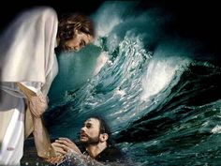
Community service and compassion ministries
Bridging the gap for holistic ministry

Slide 3
Too often we underestimate the power of a touch, a smile, a kind word, a listening ear, an honest compliment or the smallest act of caring all of which have the potential to turn a life around.

Slide 4
WHAT IS ADVENTIST COMMUNITY SERVICES (ACS)
?
ACS is a community outreach ministry of the Seventh-day Adventist Church that umbrellas at least seven main services.
One of life’s most persistent and urgent question is
“What are we doing for others?”

Slide 5

Community Services
Emotional and Spiritual Care
Young Adult Emergency Services Corps (YES)
Older Adult Ministry
Community Development/Urban Ministry
Tutoring and Mentoring
Hope for Humanity
Disaster Response

Slide 6
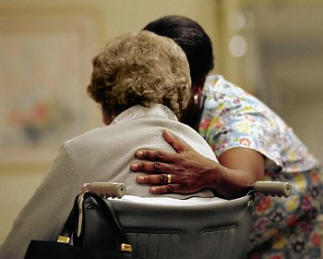
WHAT IS COMPASSION MINISTRIES
Compassion alludes to kindness and sympathy, but there is something deeper, even more profoundly powerful, in its meaning.
Our sorrows and wounds are healed only when we touch
them with compassion.
- Buddha

Slide 7
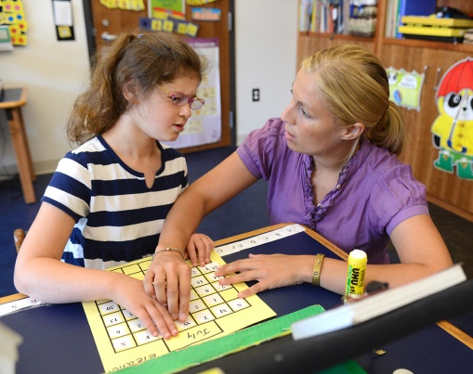
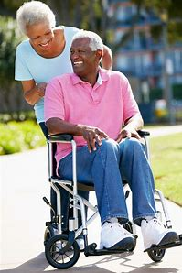
Compassion ministries
Providing education, services and resources for the:
Blind/visually impaired
Hearing Impaired/deaf
Mentally Challenged
Physically Challenged

Slide 8
THE DIFFERENCE BETWEEN COMPASSION MINISTRIES AND COMMUNITY SERVICES
COMMUNITY SERVICES
Exists in the actions of working for the downtrodden and needy in society
Has to do with the Productive actions that uplift society
COMPASSION MINISTRIES
Deal with the deep awareness of the suffering of another, coupled with the emotion and desire to relieve it.
Involves the sharing of emotions of pity, concern, empathy for one’s hardships

Slide 9
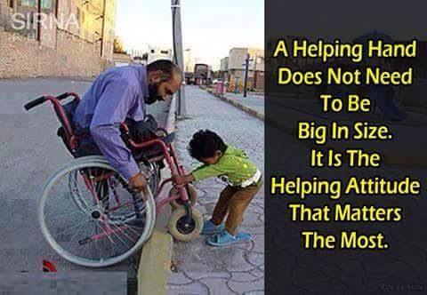

Slide 10
Disabilities Ministries

Slide 11
Questions
What is church?
What is ministry?
Why do we do it?
Why is church and ministry so inviting?
Notes:
When someone is introduced to a Christ follower or they attend church for the first time, do they feel welcome?
Do they feel like they have found a home with people that are just like them?

Slide 12
Fellowship and Nurturing
Two words that are at the heart of our church and our ministry.
These two words are inter-related and inter-connected.
These two wards are:
Fellowship
Nurturing
Fellowship and nurturing are our “why” for doing what we do.
Notes:
It is why we build churches. It is why we involve ourselves in ministry.

Slide 13
Fellowship and Nurturing
Fellowship is why people come to church, and why they involve themselves in ministry.
Nurturing is why we stay in the church.
Fellowship and nurturing are first and foremost about our personal relationship with God.

Slide 14
1 Corinthians 1:9
God is faithful, by whom you were called into the fellowship of His Son, Jesus Christ our Lord.

Slide 15
Fellowship and Nurturing
They are about unity and partnership with each other.

Slide 16
Philippians 2:1-2
Therefore if there is any consolation in Christ, if any comfort of love, if any fellowship of the Spirit, if any affection and mercy, ² fulfill my joy by being like-minded, having the same love, being of one accord, of one mind.

Slide 17
Fellowship and Nurturing
That unity and partnership are what helps us go through some of our toughest times.
They help to encourage us.

Slide 18
James 5:16
Confess your trespasses^{[a]} to one another, and pray for one another, that you may be healed. The effective, fervent prayer of a righteous man avails much.

Slide 19
Fellowship and Nurturing
Fellowship and Nurturing are about taking action.
Fellowship and nurturing are about love. Because God is love and everything that God does in about love.
Therefore, everything we do should be based in love.
Why?
We have experience God’s love which MUST be shared.
We have wisdom given to us by God.
We have the time to minister with Jesus to save ourselves and others.
Notes:
You may feel a need to do something wonderful in your community because you see the need there, but maybe your ministry is something smaller than that. You have no idea how comforting it is just to say “Hello” or to ask someone “What can I do to help with today?” Those little actions make huge differences in an individual’s life.

Slide 20
Compassion Ministries Leader’s Job Description
Your mission is to promote the full inclusion of adults and children with disabilities in your church as they develop their spiritual gifts and grow in their relationship with God.

Slide 21
Job Description
You are responsible for educating your local church leaders and church members about welcoming and including members with disabilities, as well as, ministering to people with disabilities in the community.

Slide 22
Job Description
As Seventh-day Adventists, we have a higher mandate than civil laws to welcome, accommodate and include individuals with disabilities into our congregation.

Slide 23
John 13:34-35
³⁴ A new commandment I give to you, that you love one another; as I have loved you, that you also love one another. ³⁵ By this all will know that you are My disciples, if you have love for one another.”

Slide 24
Jesus
Of the 35 miracles that Jesus performed,
27 were for people with disabilities’
An estimated 77% of His time was spent in ministering to those with disabilities.
Jesus’ life demonstrated the importance of reaching all with the Gospel message.

Slide 25
John 13:34-35
³⁴ A new commandment I give to you, that you love one another; as I have loved you, that you also love one another. ³⁵ By this all will know that you are My disciples, if you have love for one another.”

Slide 26
Mission
To support all people in their relationship with God.
To promote full inclusion of church members with disabilities in church activities, including worship, education, fellowship, service, and leadership.

Slide 27
Mission
To nurture all people as they develop and use their talents given by God.
To educate local church leaders about the needs of adults and children with disabilities.

